Slide 1

CMP3010: Computer Architecture
Pipelining Hazards
Mayada Hadhoud
Computer Engineering Department
Cairo University
Notes:
1

Slide 2
Agenda
Pipelining Hazards
Structural Hazards
Structural Hazards Solutions
Data Hazards
Data Hazards Solutions
Control Hazards
Control Hazards Solutions
Exceptions

Slide 3
Question??
Assume
Fetch = 10 ns
Decode = 6 ns
Execute = 8 ns
Memory = 10 ns
Write back = 6 ns
What is the speedup of a pipelined processor Vs. Single cycle processor and Multi cycle processor ?
Given : Number of instructions is 1000 instruction (50% add and sub instructions, 10% load , 10% store, 30% branch)
Notes:
Single cycle:
40 ns cycle time
Total time = 1000x 40=40000ns
Multi cycle:
Cycle time=10ns
Add/sub:4 cycles
Load:5 cycles
Store:4 cycles
Branch:3 cycles
Total time=600x40+100x50+300x30=24000+5000+9000=38000
Pipeline:
Cycle time= 10 ns
Total time= 1000x10+40=10040ns
Speed up single=4
Speed up multi = 3.8
3

Slide 4
Pipeline Hazards
Hazards: Situations that prevent an instruction from being executed in its designated clock cycle
Types of Hazards
Structural Hazards: two different instructions use same h/w in same cycle
Data Hazards: An instruction depends on the results of previous instruction
Control Hazards: When an instruction changes PC, like branches
The simplest hazards solution is to stall the pipeline (some instructions are allowed to proceed, while other are delayed)

Slide 5
Structural hazards
No two instructions are processed by the same module at the same time.
Solutions:
Stalling the pipeline (inserting bubbles)
Hardware Duplication

Slide 6
Structural hazards
Examples
Instruction fetch is conflicting with data memory access
Use two separate caches one for instructions and one for the data.
Register file is accessed by the instruction in the decode (reading) and the instruction in the write-back (writing)
Ensure that writing is done in the first half of the clock and reading is done at the second half of the clock

Slide 7
Structural Hazards
When two or more different instructions want to use same hardware resource in same cycle
e.g., MEM uses the same memory port as IF as shown in this slide.
Time (clock cycles)
Cycle 1
Cycle 2
Cycle 3
Cycle 4
Cycle 5
Cycle 6
Cycle 7
I
n
s
t
r.
O
r
d
e
r
Load
Ifetch
Reg
ALU
DMem
Reg
Instr 1
Ifetch
Reg
ALU
DMem
Reg
Instr 2
Ifetch
Reg
ALU
DMem
Reg
Instr 3
Ifetch
Reg
ALU
DMem
Reg
Instr 4
Ifetch
Reg
ALU
DMem
Reg
Appendix A - Pipelining
7
Notes:
7

Slide 8
Structural Hazards
Time (clock cycles)
Cycle 1
Cycle 2
Cycle 3
Cycle 4
Cycle 5
Cycle 6
Cycle 7
This is another way of looking at the effect of a stall.
I
n
s
t
r.
O
r
d
e
r
Load
Ifetch
Reg
ALU
DMem
Reg
Instr 1
Ifetch
Reg
ALU
DMem
Reg
Instr 2
Ifetch
Reg
ALU
DMem
Reg
Stall
Bubble
Bubble
Bubble
Bubble
Bubble
Instr 3
Ifetch
Reg
ALU
DMem
Reg
8
Notes:
8

Slide 9
Data Hazards
An occurrence in which a planned instruction cannot execute in the proper clock cycle because data that is needed to execute the instruction is not yet available.

Slide 10

Data Hazards
Data hazards arise from the dependence of one instruction on an earlier one that is still in the pipeline.
Example:

Slide 11
Example
Time (clock cycles)
IF
ID/RF
EX
MEM
WB
I
n
s
t
r.
O
r
d
e
r
add r1,r2,r3
Ifetch
Reg
ALU
DMem
Reg
sub r4,r1,r3
Ifetch
Reg
ALU
DMem
Reg
and r6,r1,r7
Ifetch
Reg
ALU
DMem
Reg
or r8,r1,r9
Ifetch
Reg
ALU
DMem
Reg
xor r10,r1,r11
Ifetch
Reg
ALU
DMem
Reg

Slide 12
Data Hazards- Solutions
Solution (1): Software-solution: Compiler arranges instructions to avoid data dependencies
Solution (2): Data Forwarding “or bypassing”: forward the data back to the requesting stage “immediately when it is available”
Solution (3): Stalling the pipeline: inserting bubbles and stall the instruction till the data is written back

Slide 13
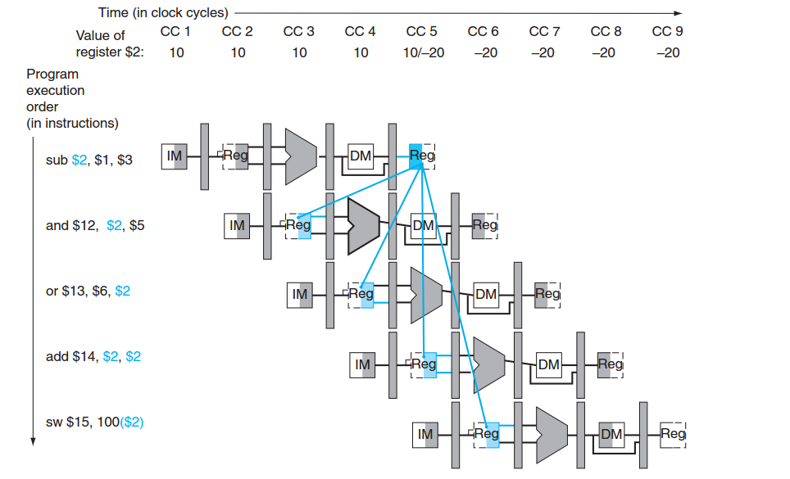
Data Forwarding

Slide 14
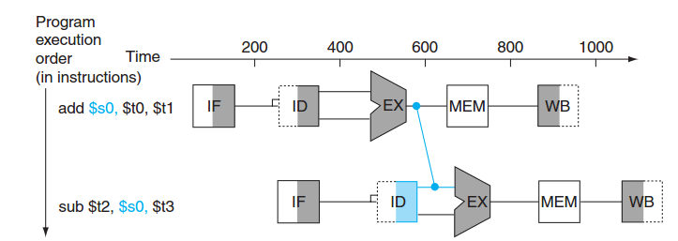
Data Forwarding

Slide 15
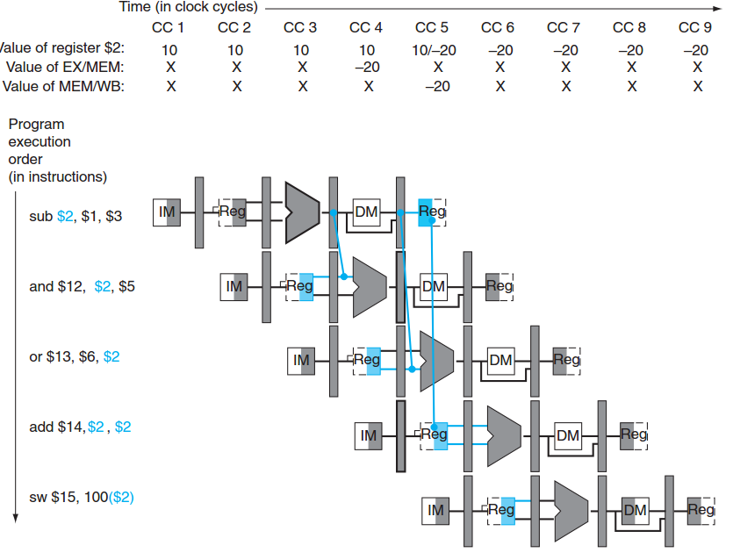

Slide 16
HW Change for Forwarding
NextPC
ID/EX
EX/MEM
MEM/WR
mux
Registers
ALU
Data
Memory
mux
mux
Immediate
16

Slide 17
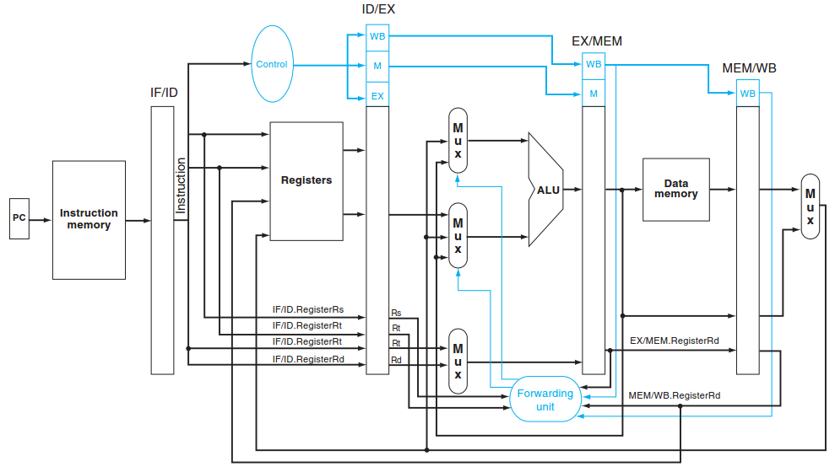
Notes:
1. EX hazard:
if (EX/MEM.RegWrite and (EX/MEM.RegisterRd 0)
and (EX/MEM.RegisterRd = ID/EX.RegisterRs)) ForwardA = 10
if (EX/MEM.RegWrite and (EX/MEM.RegisterRd 0)
and (EX/MEM.RegisterRd = ID/EX.RegisterRt)) ForwardB = 10
2. MEM hazard:
if (MEM/WB.RegWrite and (MEM/WB.RegisterRd 0)
and (MEM/WB.RegisterRd = ID/EX.RegisterRs)) ForwardA = 01
if (MEM/WB.RegWrite and (MEM/WB.RegisterRd 0)
and (MEM/WB.RegisterRd = ID/EX.RegisterRt)) ForwardB = 01
if (MEM/WB.RegWrite and (MEM/WB.RegisterRd 0) and (EX/MEM.RegisterRd ID/EX.RegisterRs)
and (MEM/WB.RegisterRd = ID/EX.RegisterRs)) ForwardA = 01
if (MEM/WB.RegWrite and (MEM/WB.RegisterRd 0) and (EX/MEM.RegisterRd ID/EX.RegisterRt)
and (MEM/WB.RegisterRd = ID/EX.RegisterRt)) ForwardB = 01
17

Slide 18
Load-Use Data Hazard
A specific form of data hazard in which the data requested by a load instruction has not yet become available when it is requested.

Slide 19
Time (clock cycles)
I
n
s
t
r.
O
r
d
e
r
lw r1, 0(r2)
Ifetch
Reg
ALU
DMem
Reg
sub r4,r1,r6
Ifetch
Reg
ALU
DMem
Reg
and r6,r1,r7
Ifetch
Reg
ALU
DMem
Reg
or r8,r1,r9
Ifetch
Reg
ALU
DMem
Reg

Slide 20
Software Scheduling to Avoid Load Hazards
Try producing fast code for
a = b + c;
d = e – f;
assuming a, b, c, d ,e, and f in memory.
Slow code:
LW Rb,b
LW Rc,c
ADD Ra,Rb,Rc
SW a,Ra
LW Re,e
LW Rf,f
SUB Rd,Re,Rf
SW d,Rd
Fast code:
LW Rb,b
LW Rc,c
LW Re,e
ADD Ra,Rb,Rc
LW Rf,f
SW a,Ra
SUB Rd,Re,Rf
SW d,Rd

Slide 21
Time (clock cycles)
I
n
s
t
r.
O
r
d
e
r
lw r1, 0(r2)
Ifetch
Reg
ALU
DMem
Reg
Bubble
sub r4,r1,r6
Ifetch
Reg
ALU
DMem
Reg
Bubble
and r6,r1,r7
Ifetch
Reg
ALU
DMem
Reg
Bubble
Ifetch
Reg
ALU
DMem
Pipeline should be stalled till the data becomes available

Slide 22
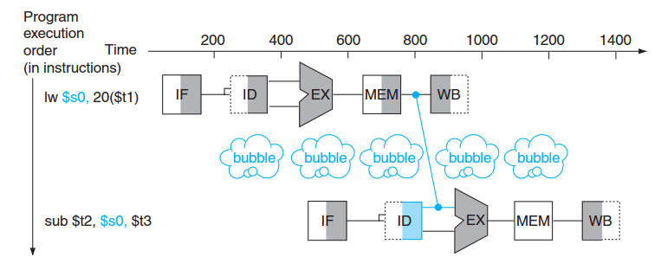
Load-Use Data Hazard

Slide 23
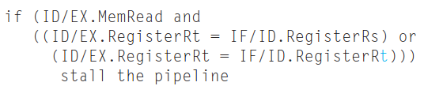
Load-Use Data Hazard
Load-Use Hazard check
Is the instruction is load ??
How can we insert NOP in the pipe??
Notes:
NOP: changing the EX, MEM, and WB control fields of the ID/EX pipeline register to 0. an it will propagate to the next registers
23

Slide 24
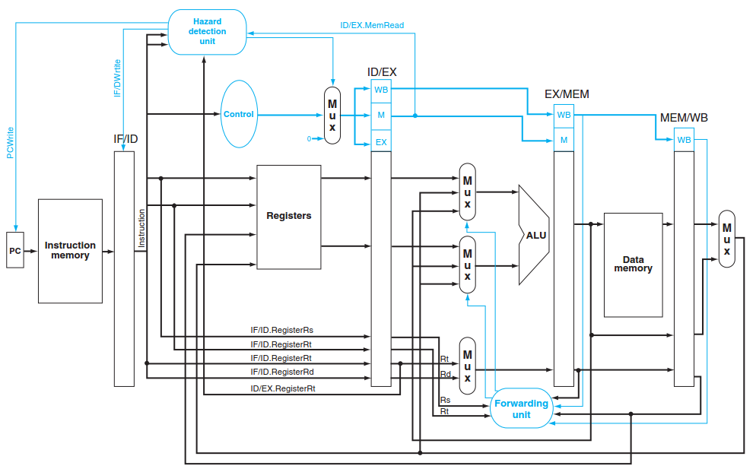
Data Hazard Detection H/W

